Slide 1
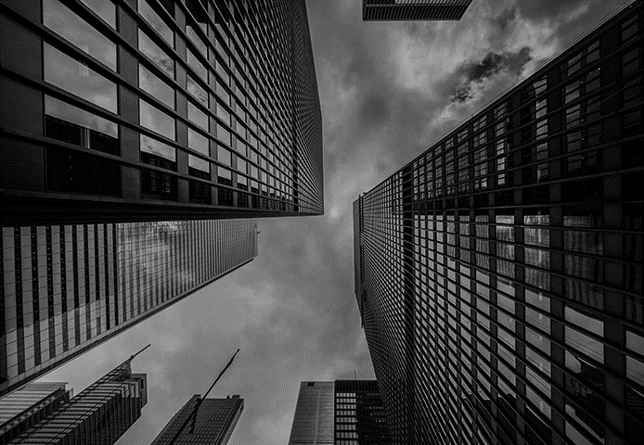

Unlocking Low Carbon Economy Through Buildings
Anusha Jindgar
Sameer Shankar
Ting Guo

Slide 2
Identifying the Problem
According to the International Energy Agency and Architecture2030.org, carbon emissions play a key role in escalating global warming. Buildings in particular contribute to 35-60% of global carbon emissions. British Columbia follows the same trend.
Getting to net zero will require tremendous, rapid change and large-scale technology deployment across industries.
Given how significantly buildings impact carbon emissions in BC, through this policy we aim to make environment conservation and economic development two sides of the same coin.
Notes:
According to the International Energy Agency and Architecture2030.org, carbon emissions play a key role in escalating global warming. Buildings in particular contribute to 35-60% of global carbon emissions. British Columbia follows the same trends with some municipalities emitting 30-60% of emissions.

Slide 3
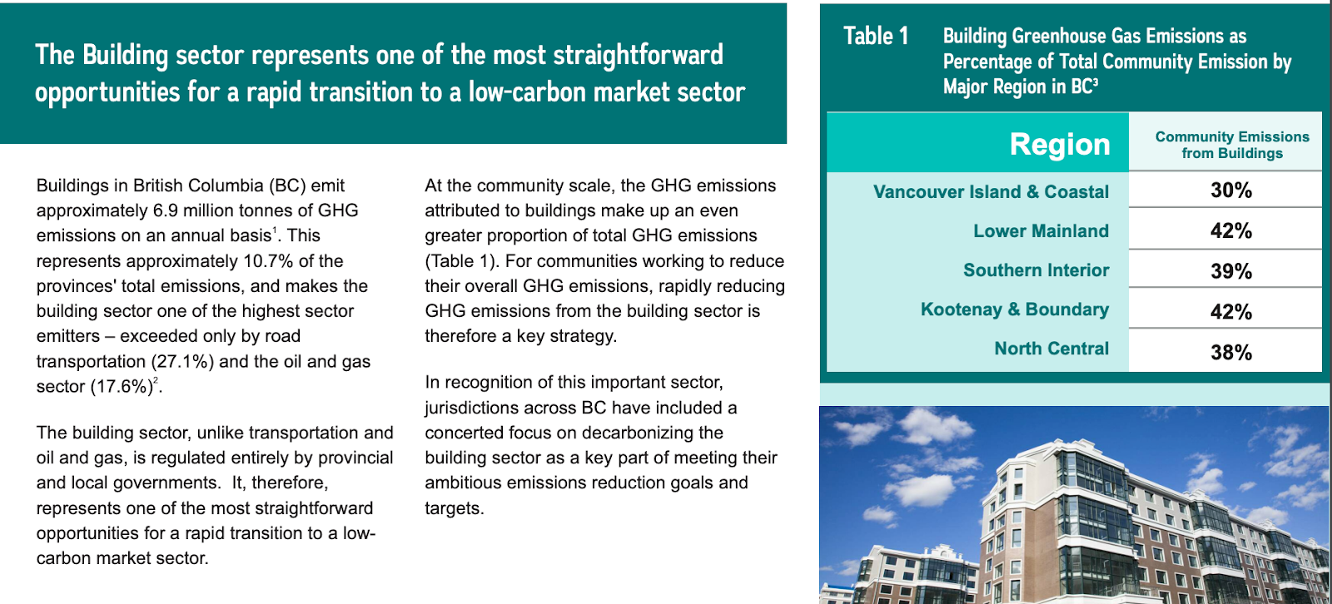
Buildings account for 11% of total emissions in British Columbia
- BC Building Electrification Road Map Final Apr2021

Slide 4
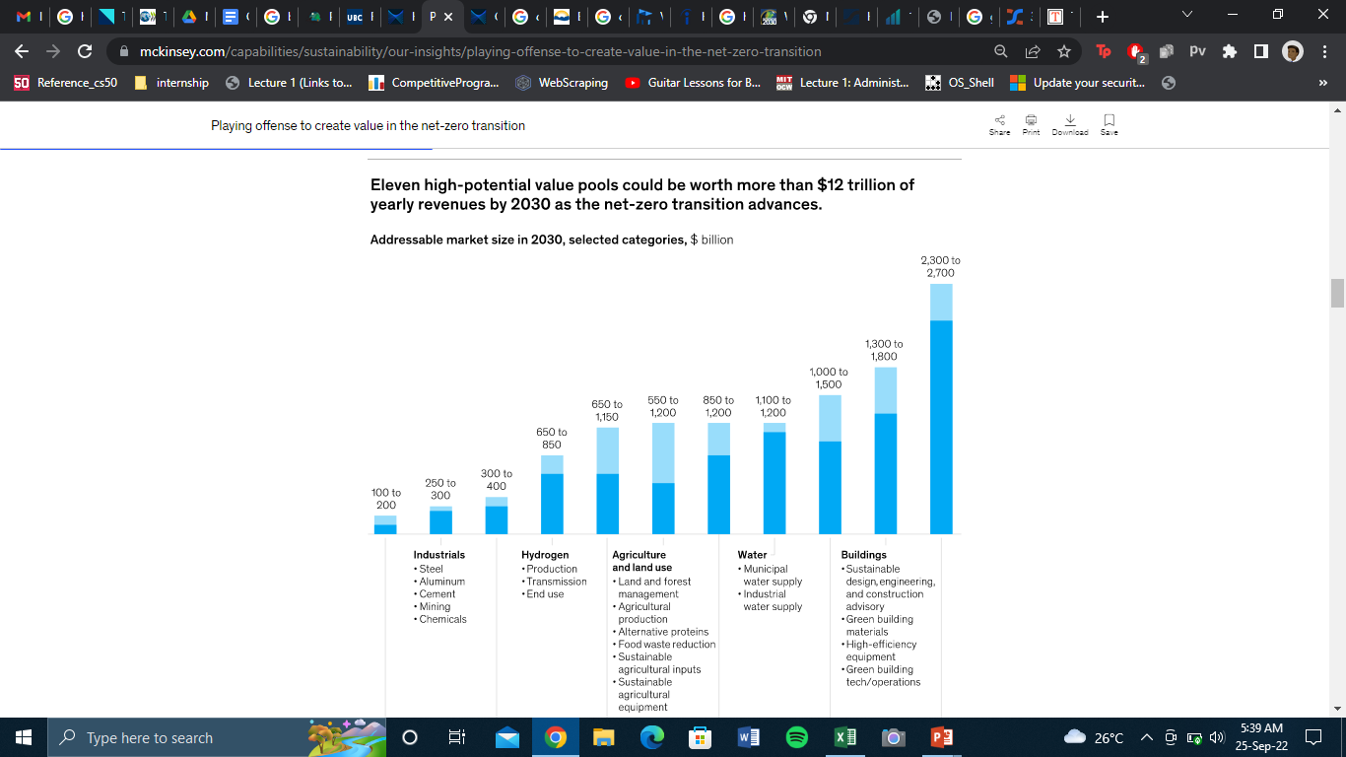
Why Buildings?
Even though buildings are a big contributor to global CO2 emissions, they present a unique avenue for revenue generation, if tackled properly.

Slide 5
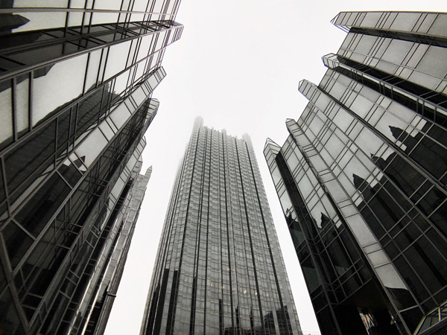
Machine Learning Model
Notes:
Machine Learning is a buzzword thrown around these days, however it is in fact very important in making predictions based on data. We wanted to use machine learning in order to support the solutions we have created.

Slide 6
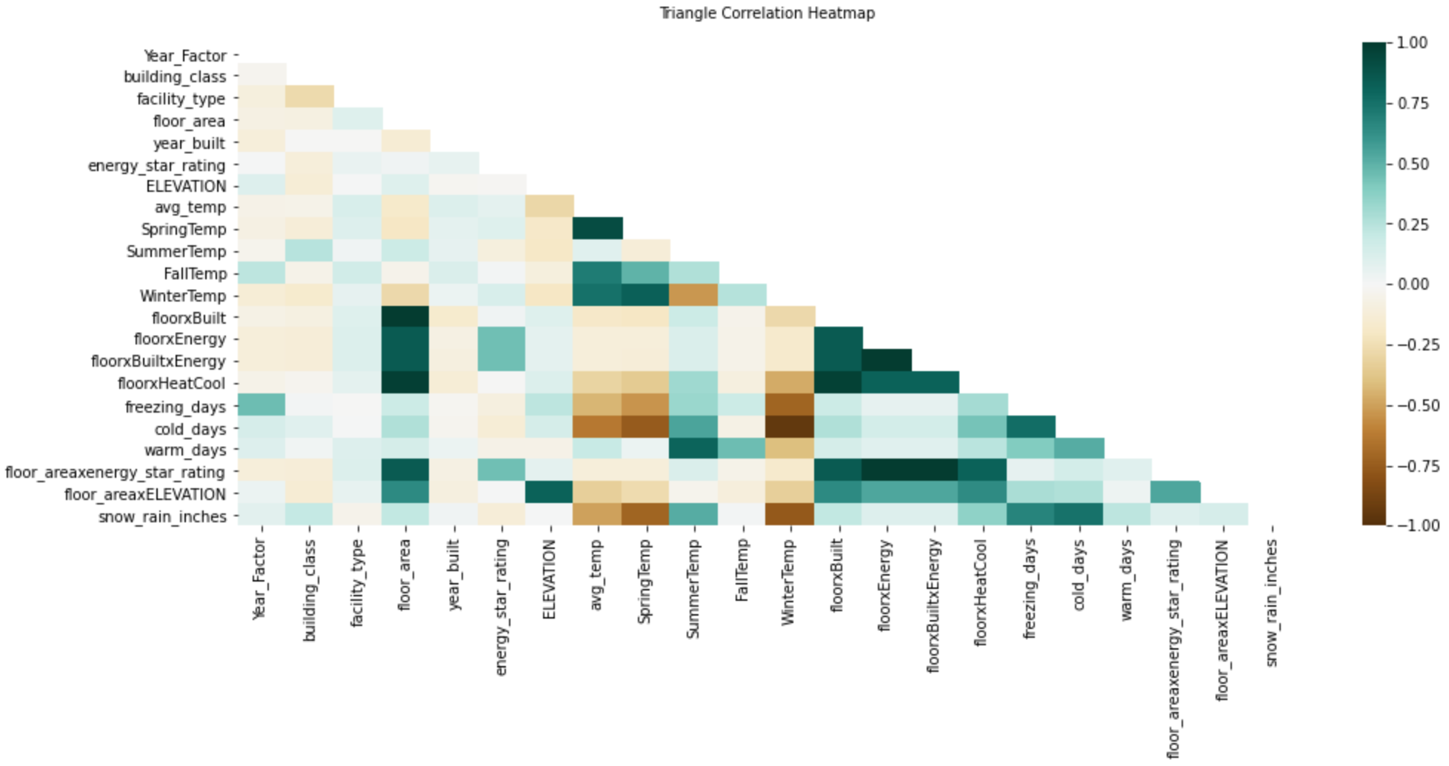
Notes:
Using Python, we analyzed a dataset, and then generated a correlation heatmap that allows us to narrow down the important factors when predicting building energy usage. For example, we found that Energy Star Rating was the most important predicting feature.

Slide 7
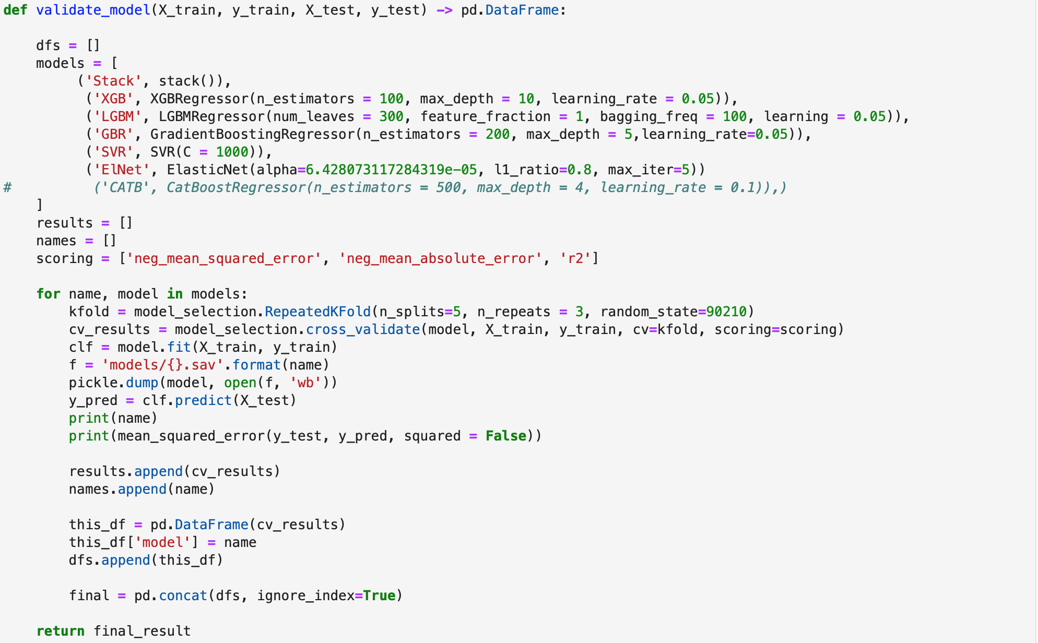
Notes:
And here we see code that is incredibly boring, but complex and important. Here we are running algorithms that predict the energy usage by buildings. Through this we can identify the buildings that use a large amount of energy and focus our attention on them in the future.

Slide 8




Solutions
Provide negative and positive reinforcement to citizens by creating an upper and lower limit to CO2 emissions
Threshold Creation
Three Step Residential Pricing
Change BC Hydro’s current 2 step residential electricity pricing to 3 step
Offer programs and scholarships that allow students to develop the necessary skills needed in today's green tech environment
University Program + Scholarship
Notes:
Now that we have looked at the data, let us focus on the solutions. We have produced a THREEFOLD solution to tackle the issue; threshold creation, three step residential pricing and university programs/scholarships.

Slide 9
Threshold Creation
Corporations with annual CO2 emissions higher than 23.77kg/ft^2, would be required to invest 5 % of their revenue to green tech startups
Corporations and households with annual CO2 emissions lower than 10.52kg/ft^2, would get benefits that would make their energy bill negligible, making housing more affordable.
23.77 kg/ft^2
10.52 kg/ft^2
Notes:
The idea behind threshold creation is to set an upper and lower bound of carbon emissions. What this means is buildings that exceed 23.77 kg/ft^2 will be penalized in the form of transferring 5% of their annual revenue to green tech startups.
On the flipside, corporations and households with annual CO2 emissions lower than 10.52 kg/ft^2 will get benefits that would make their energy bill negligible, making housing more affordable.

Slide 10
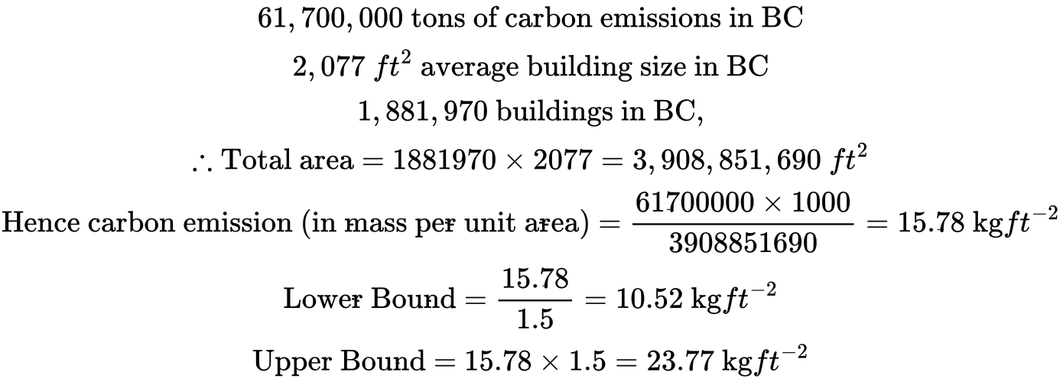
Math Behind Threshold Approximation
Notes:
So, we have the facts and figures for total carbon emissions, average building size and number of buildings for BC.

Slide 11
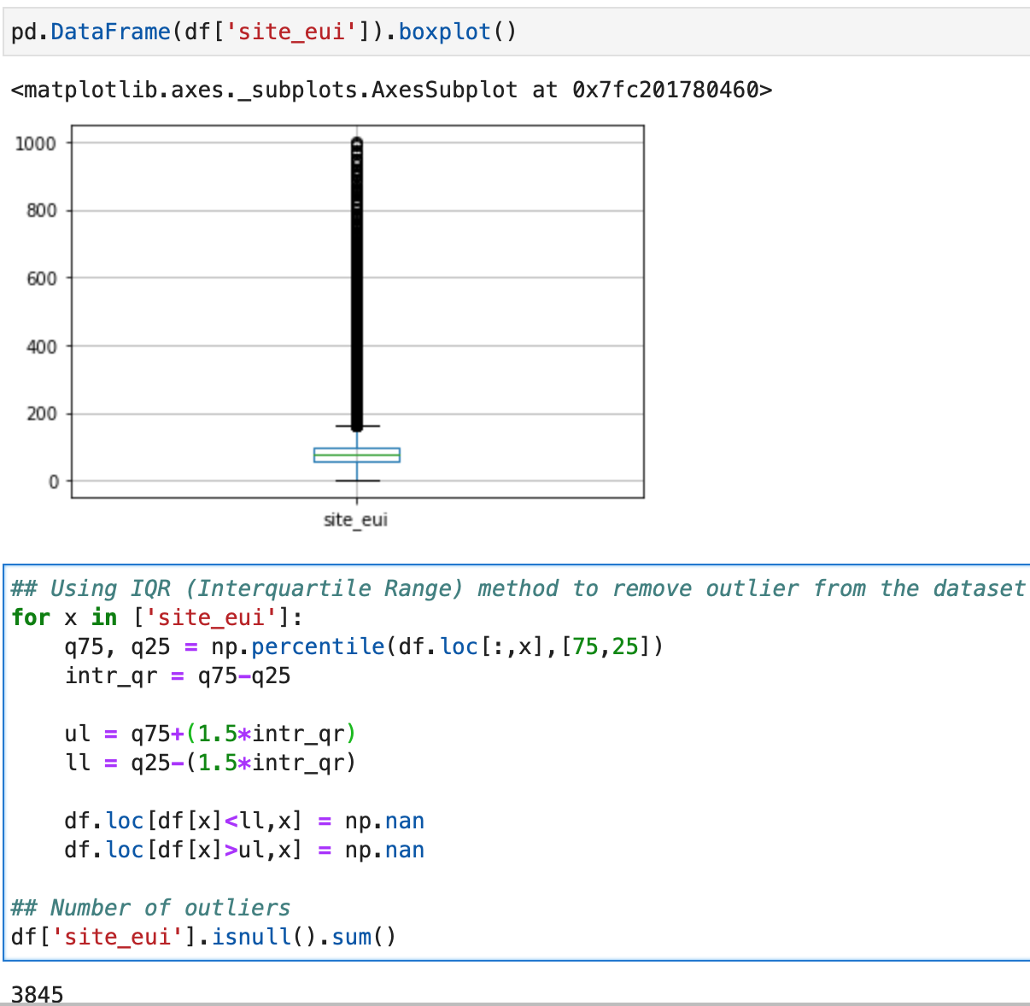
Biggest Takeaways:
1. There are 3845 households that are consuming significantly large amount of energy. This would create a good revenue pool for our upper-bound strategy, making it economical.
2. There is NO household that is currently producing lower than the threshold. As a result, the cost of implementing the lower-bound strategy would be negligible.
Notes:
We found 3845 households consuming a significantly large amount of energy, which would result in a sizeable investment into the green tech industry.
We also found there to be no households that currently produce below the lower threshold, which would result in minimal costs when implementing this solution.

Slide 12
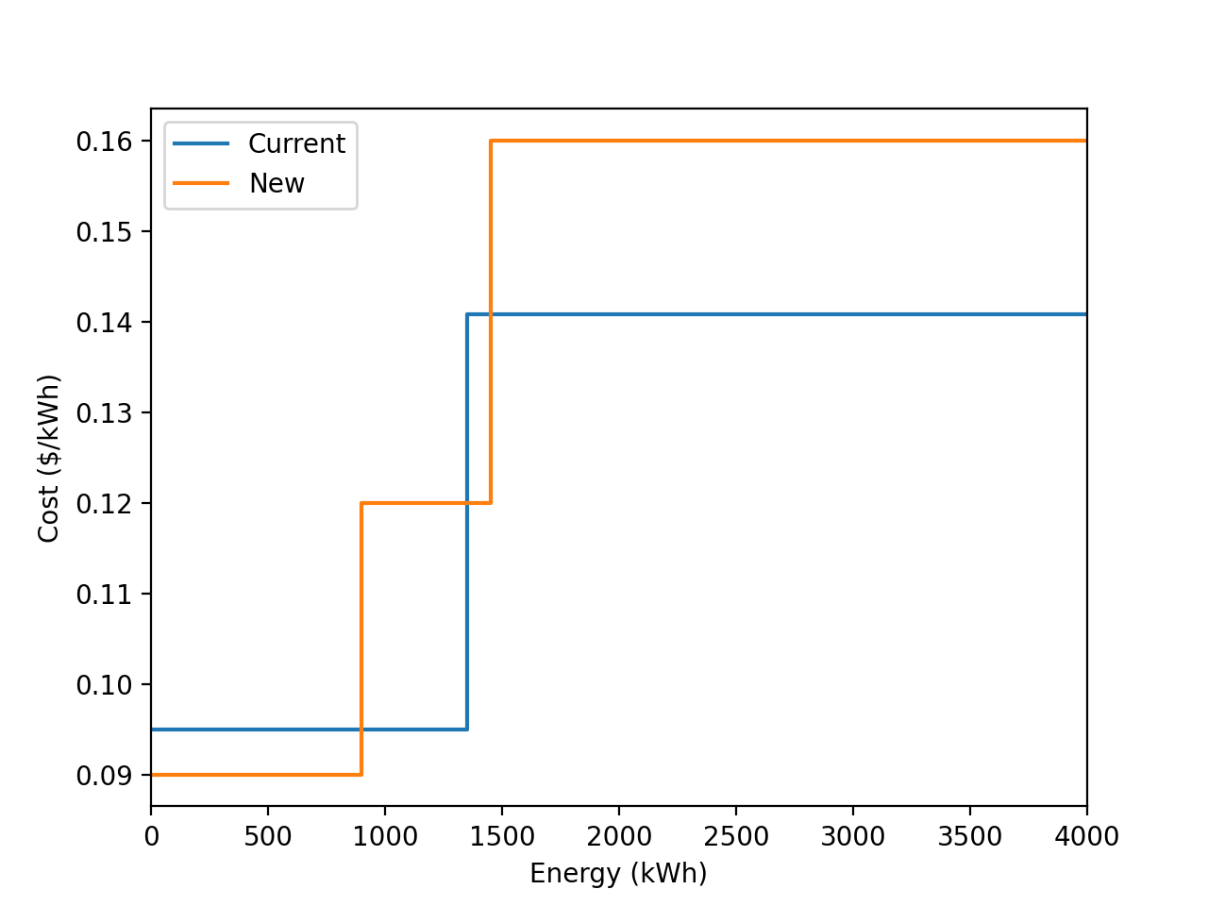
Three Step Residential Pricing
BC Hydro's current 2-step pricing for residential buildings would be upgraded to a 3-step pricing system. Through that system, buildings with significantly low energy consumption would pay low cost for energy. Buildings with significantly high energy consumption would pay a much higher cost.
Notes:
The previous solution is designed mainly for corporations, and now we introduce our solution for residentials.
The unit cost of first step in the new model is lower than the first step in the old model, and the unit cost of third step in the new model is higher than the second step in the old model. With this setup, …

Slide 13
University Program
Offering university courses designed to help students gain necessary skills to succeed in today’s green tech industry
Creating competitions for students where they have to ideate new green tech models
Offering top 5 winners scholarships and/or placements in startups linked to the competition
Promoting such courses and competitions especially amongst the indigenous communities and ensuring that diversity is reflected in the winners
Notes:
Next we introduce our university program…
The logistics that we need to consider while implementing this solution include factors such as what kind of professor we need to teach the course, getting dept authorization, and budget considerations.

Slide 14

Stakeholders
Homeowners
Businesses
Indigenous Communities
Green tech companies
Students
Workforce
Notes:
Moving on, we identify the stakeholders that will be impacted by our strategies, which are businesses, …

Slide 15
Economic Growth
Homeowners
Businesses
Green Tech Company
Students
Workforce
Indigenous Communities
Making housing more affordable (lower threshold + three step pricing)
Nudging them to increase their energy efficiency and rewarding them through lower threshold benefits
Increasing investments and market demand
University programs, placements and scholarships
Job creation in green tech industry
Ensuring their inclusion in university scholarship programs and placement opportunities
Notes:
For businesses, in addition to current requirement to corporations, we hope that taking away part of their revenue would act as a negative reinforcement and promote green economy

Slide 16
Financial Analysis
Given the historic trend of energy consumption presented by the boxplot shown on the right:
We expect 3845/75757 = 5% of the buildings to have excessive energy consumption (over the upper limit threshold). This would ensure a healthy investment into the green tech industry by corporations.
Secondly, there are not a lot of buildings (if any) that lie below the lower threshold. This suggests that, at the moment, the cost of implementing this policy is not significant. However, we do expect the number to rise in the future. Then, the policy would have to be changed accordingly.
Notes:
As mentioned previously, the cost of implementing will be minimal, while generating money for the green tech industry.

Slide 17
Roadmap
University programs and scholarships
Creating awareness about the threshold requirements and implications
Putting systems in place to increase BC Hydro’s residential pricing system from 2 to 3
OUTCOMES (2030)
Expanding consumer base for green technology
Improving the knowledge and readiness of students (future workforce)
Encouraging the use of low carbon materials in building construction
Making green housing more affordable in BC
2026
2025
2023

Slide 18
Risk Assessment
Risk Identification
Corporations that exceed the upper level threshold could attempt to not truly invest in green technology by setting up smaller sister companies and transferring 5% of their revenue there.
This would ensure that the money would stay within the big corporation and not get invested in technology development
Risk Mitigation
Government could release a list of certified green tech startups that corporations would have to invest in should they exceed the upper limit
It would be mandatory for the corporations to disclose the money transferred to government certified startups
It would be mandatory for startups to show what they have done with the investment
Notes:
Finally, we assess risks associated with our strategies…

Slide 19

Thank You

